Slide 1
By: Oscar Cardenas

Slide 2
Why Recycle?
Saves natural resources- By making products from recycled materials instead of virgin materials, we conserve land and reduce the need to drill for oil and dig for materials.
Saves Energy- It usually takes less energy to make recycled products. It always takes less energy to make a new product from recycled materials than it does to make it from new materials.

Slide 3
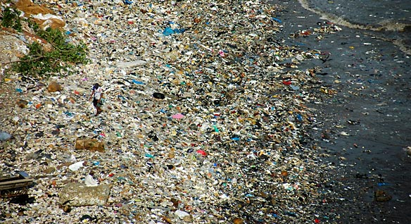
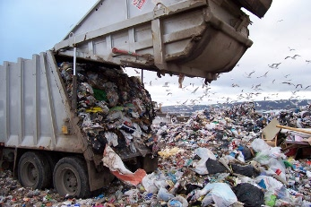
Recycling benefits
Saves Clean Air and Water- In most cases making products from recycled materials creates less air pollution and water pollution than making products from virgin materials.
Saves Landfill Space- When the materials that you recycle go into new products, they don’t go into landfills or incinerators, so landfill space is conserved.

Slide 4
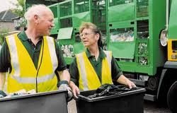
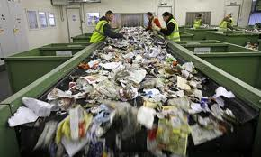
A Recycling myth
Recycling doesn’t save money nor creates job- the recycling process creates far more jobs than landfills or incinerators, and recycling can frequently be the least expensive waste management method for cities and towns.

Slide 5
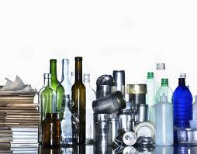
Statistics
Recycling aluminum requires 96% less energy than manufacturing aluminum from its virgin material.
Plastic bottles-76% less energy
Paper use-45%
Glass- 21%

Slide 6
Pollution
Ton for ton, recycling reduces more pollution, saves energy and reduces GHG emissions more than any other solid waste management option. According to the California Integrated Waste Management Board, over 60% of the garbage in the landfills can be composited or recycled.

Slide 7
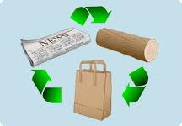
Saves Natural Resources
By reusing materials more than once we conserve natural resources ensuring our children's futures.
California's recycling saves 14 million trees each year and helps reduce air pollutants by 165,142 tons.
Making a ton of paper from recycled stock saves up to 17 trees and uses 59% less water (that’s 7000 gallons).

Slide 8
Wildlife
Recycling also preserves wildlife. When fewer trees are cut down to make virgin materials or to make space landfills, habitat for wildlife remains. More habitat for animals means less animal extinction.

Slide 9
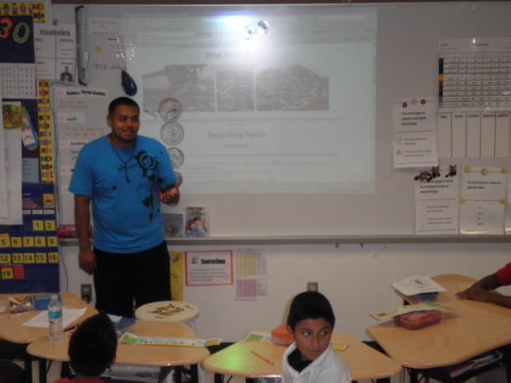
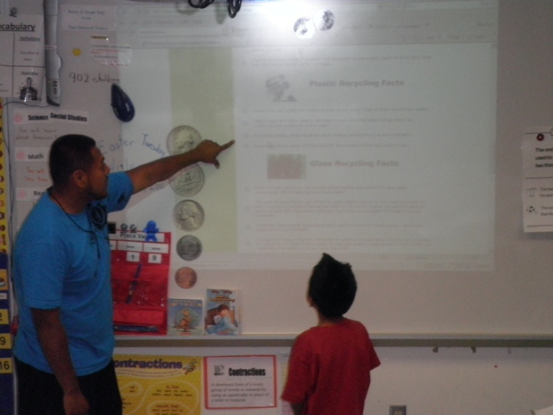
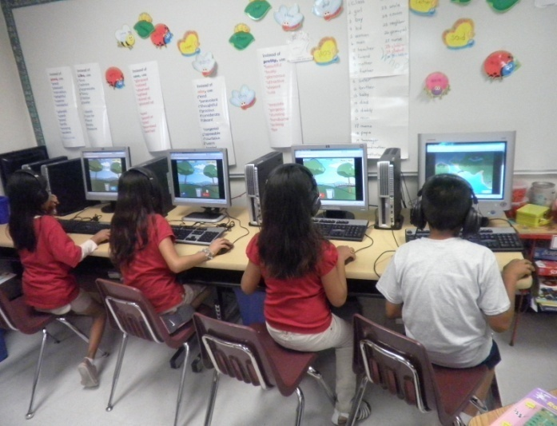
How can I help?

Slide 10
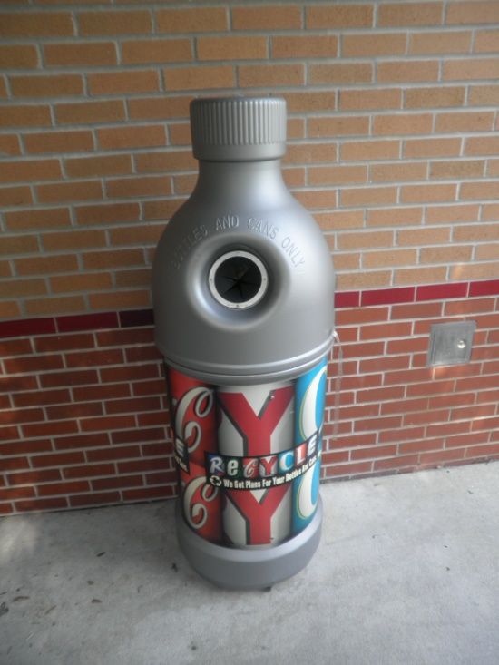
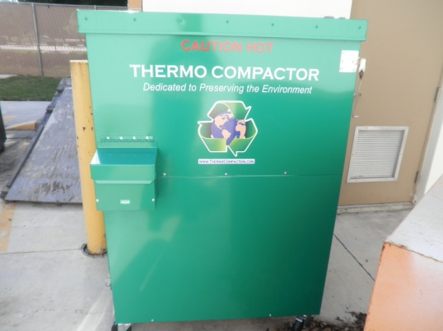
How to help?

Slide 11
Miscellaneous

